Slide 1


Frank ma2n0230
Uguumur ma2n0248
Theo ma2n0232
Tamara Rossegger 0a20f366

Slide 2

What makes Yahoo! an attractive opportunity (and not just a good idea?)

Slide 3

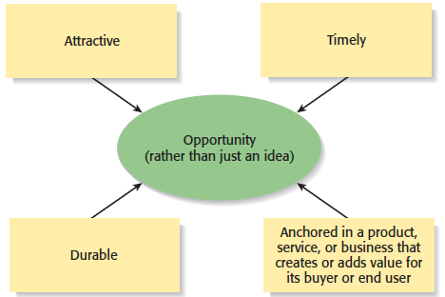

Slide 4
ATTACTIVE
In 1995, Yahoo! was an attractive opportunity as a business. There are several uniqueness of Yahoo! among Internet search engines:
* The word "yahoo" is an acronym for "Yet Another Hierarchical Officious Oracle". The hierarchy of Yahoo! is a handcrafted tool in that all of its… categories were designated by people, not computers. The sites that they link to are likewise deliberately chosen, not assigned by software algorithms.

Slide 5
Yahoo! offered a central place where people could go to just to see what was out there. This made it easy for people with little previous exposure to the Web to start searching through Yahoo!’s lists of links, often just to see if they could find something of interest.

Slide 6
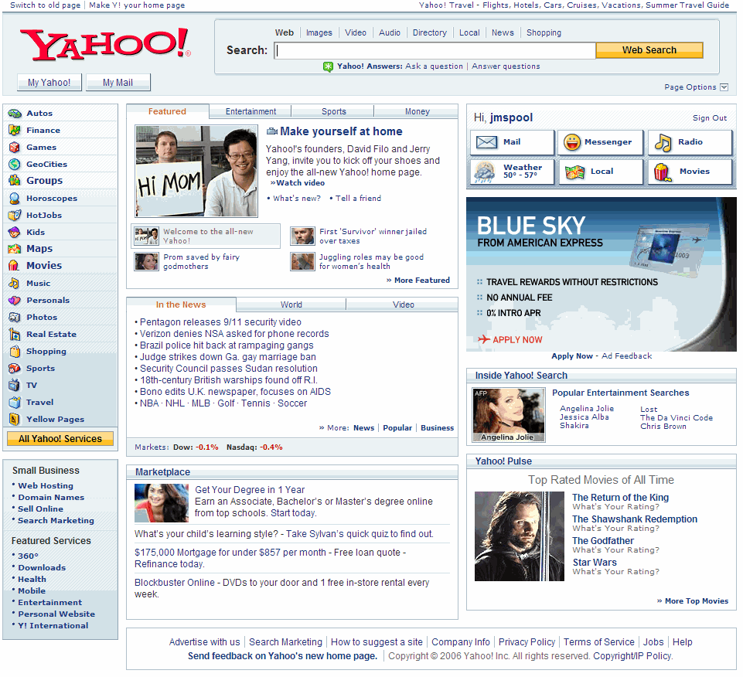

Slide 7

TIMELY
Through 1990s, Information Technology grew rapidly. At that time, many people all over the world started using personal computer (PC) as well as internet for searching information.

Slide 8

DURABLE
Searching demand is always high.
The world change everyday, including the events of culture, sport, political, social, military…

Slide 9
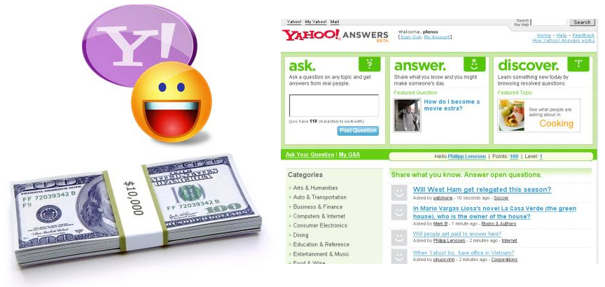
ADDS VALUE FOR END USER
Yahoo Answers offers a great Opportunity to generate money by just posting answers. The Yahoo Answer Community is going strong with millions of visitors and members. It is one of the most powerful sites where people interact with each other to ask and find answers to their questions.

Slide 10

How will Yahoo! make money
(i.e., business model)

Slide 11

Started as internet directory
Now global internet communication, commerce and media company
700million access in every single month
Lot of service and products

Slide 12
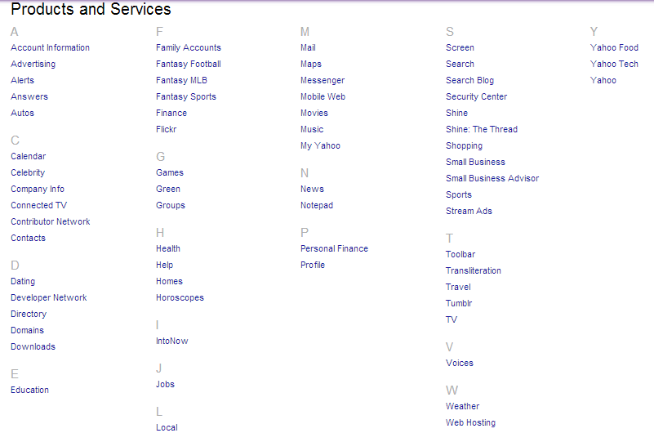

Slide 13

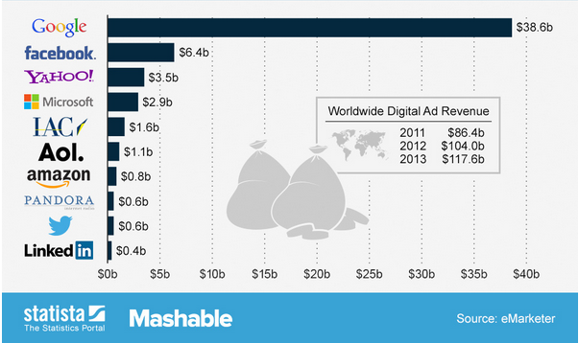

Slide 14


Identify major risks of Yahoo! in: technology, market, team and financial. Then rank order them
Risk is an expression of the extent of perceived harm that might arise from interaction with a particular hazard
Risk assessment is an evaluation of the level of risk, based on the extent (severity) of injury to a person or company following interaction with a hazard and the likelihood of that interaction occurring.

Slide 15

Multiply the two figures or find the
intersection point on the chart to arrive
at a risk score
Key Guidance
Severity | Likelihood
1 Minor Injury | 1 Remote possibility
2 First Aid Injury | 2 Possible
3 Day injury | 3 Probable
4 Major injury | 4 Highly probable
5 Fatality | 5 Inevitable

Slide 16
List identified issues | Likelihood (1 to 5) | Severity (1 to 5) | Risk Score
Technology:
Inflexibility in upgrading their website coz didn’t have their owed system | 4 | 3 | 12
Have to move their system out of Stanford campus | 4 | 3 | 12
Hard to find suitable destination to move the system in | 3 | 3 | 9
Total |  |  | 35
Market:
Have to compete with well-funded competitors | 5 | 5 | 25
Total |  |  | 25
Team:
May be fail to manage the company at beginning cos don’t have management skills | 4 | 3 | 12
Don’t have their owned plan for future | 3 | 3 | 9
Total |  |  | 21
Financial:
Cannot develop their company cos lack of money | 4 | 4 | 16
Many financial options -> difficult to take the most suitable one | 4 | 3 | 12
Have to share company’s benefits to others | 4 | 4 | 16
Cannot own 100% of company | 4 | 3 | 12
Total |  |  | 56

Slide 17

What are the advantagesand disadvantages of each of the funding options they could pursue? Which one do you recommend?

Slide 18

Form of funding | Advantages | disadvantages
Sequoia (offer 1 Million $ in exchange for 25% shares) | + assisting in building a complete management team + experience in investing in successful companies (Apple, Oracle,..) + 1 Mio $ → need the money to survive + the Yahoo! Founders like to work with Michael Moritz from Sequoia | want 25% share → not 100% fully owner of Yahoo!
Reuters (want to integrating Reuter’s news service in Yahoo!) | + providing information from a well-known source | - Poor negotiating positions because Yahoo didn’t generate revenue
ISN (interested in being a Host site for Yahoo! ; Partner-Sponsorship) | + offer the chance to generate revenues + retain 100% ownership | - being associated with a shopping network → people might get the wrong impression of Yahoo‘s services → damage for image

Slide 19

Form of funding | Advantages | disadvantages
Netscape Communications Corporation (after entering the network, Netscape offer to purchase Yahoo! In exchange for Netscape stock) | + Netscape was already planning its IPO (initial public offering) → enormous publicity + company culture fits to the Yahoo! Founders + may generate a lot of revenue in the next years | give up a lot of control → bad referring to the founder’s passion for their product
Corporate Partnerships/ sponsorships (e.g AOL,.. Offer them money, stock, management positions,…) | + decrease the chance of big competitors + retain 100% ownership | Lack of control about their “creation” pressure from big partners damage for Yahoos! Image
Wait for another option | +Get more money + can retain 100% owner | Running out of time Insecure solution

Slide 20

4 possibilities:
Accepting Sequoia‘s offer and launch Yahoo! as their own company
accept corporate sponsorship
merging with an existing corporation
not decide immediately

Slide 21

Sequoia
assisting in building a complete management team
experience in investing in successful companies (Apple, Oracle,..)
1 Mio $ → need the money to survive and they are running out of time
+ the Yahoo! Founders like to work with Michael Moritz from Sequoia
“take the best option NOW”

